Slide 1
Male and Female Reproductive Systems

Slide 2
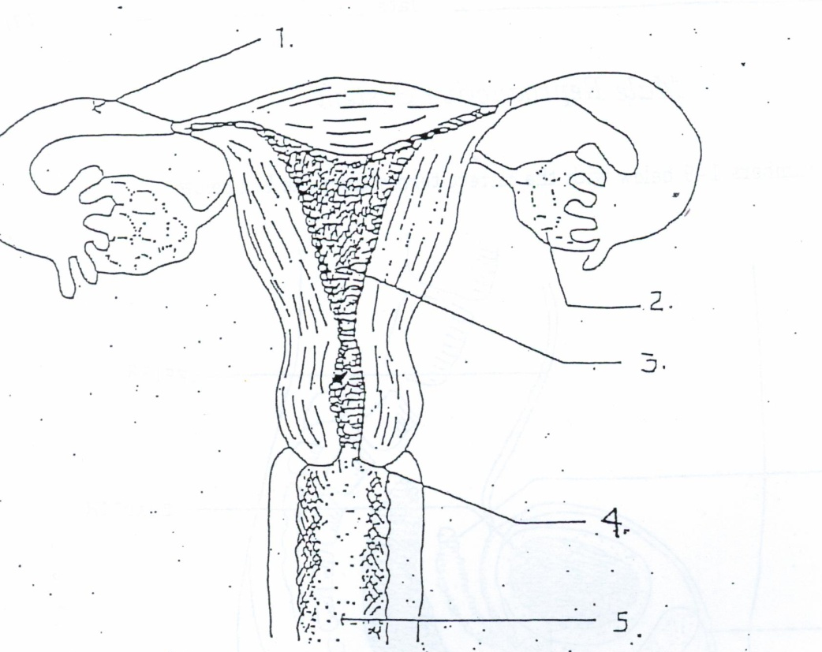
Female Reproductive System
#1 – Fallopian Tube-egg gets fertilized by sperm
#2 – Ovaries-produces egg cell, size of diamond, produce female hormone
#3 – Uterus-womb, strong, hollow muscle, safe, nourishing cavity for embryo that grows into a baby
#4 – Cervix-lower portion of the uterus, must dialate (open_ to allow baby out
#5 – Vagina-passageway to outside of body

Slide 3
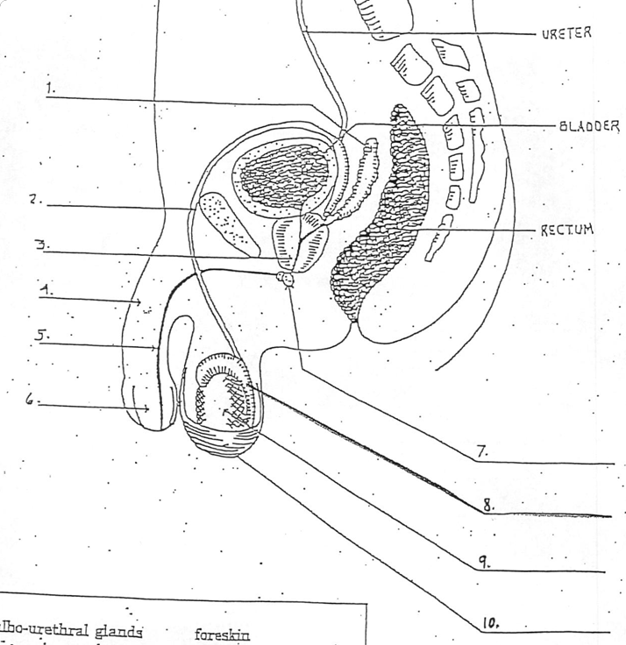
Male Reproductive System
#1 – Seminal Vesicle-2 small glands, secrete sugary fluid that provides energy for sperm
#2 – Vas Deferens-tube sperm travels through
#3 – Prostate-acidic fluid, helps sperm live long
#4 – Penis-male sex organ
#5 – Urethra-tube serves as passageway for semen and urine
#6 – Foreskin-protects
#7 – Bulbo-urethral gland (cowper’s gland) 2 glands on side of urethra, secretes lubricating fluid
#8 – Epididymis-structure on upper surface of each testicle, stores sperm
#9 – Testicle-produce sperm cells
#10 – Scrotum-sac that holds the testes, controls temperature

Slide 4
Female Reproductive System
#1 – Fallopian Tube-egg gets fertilized by sperm
#2 – Ovaries-produces egg cell, size of diamond, produce female hormone
#3 – Uterus-womb, strong, hollow muscle, safe, nourishing cavity for embryo that grows into a baby
#4 – Cervix-lower portion of the uterus, must dialate (open_ to allow baby out
#5 – Vagina-passageway to outside of body

Slide 5
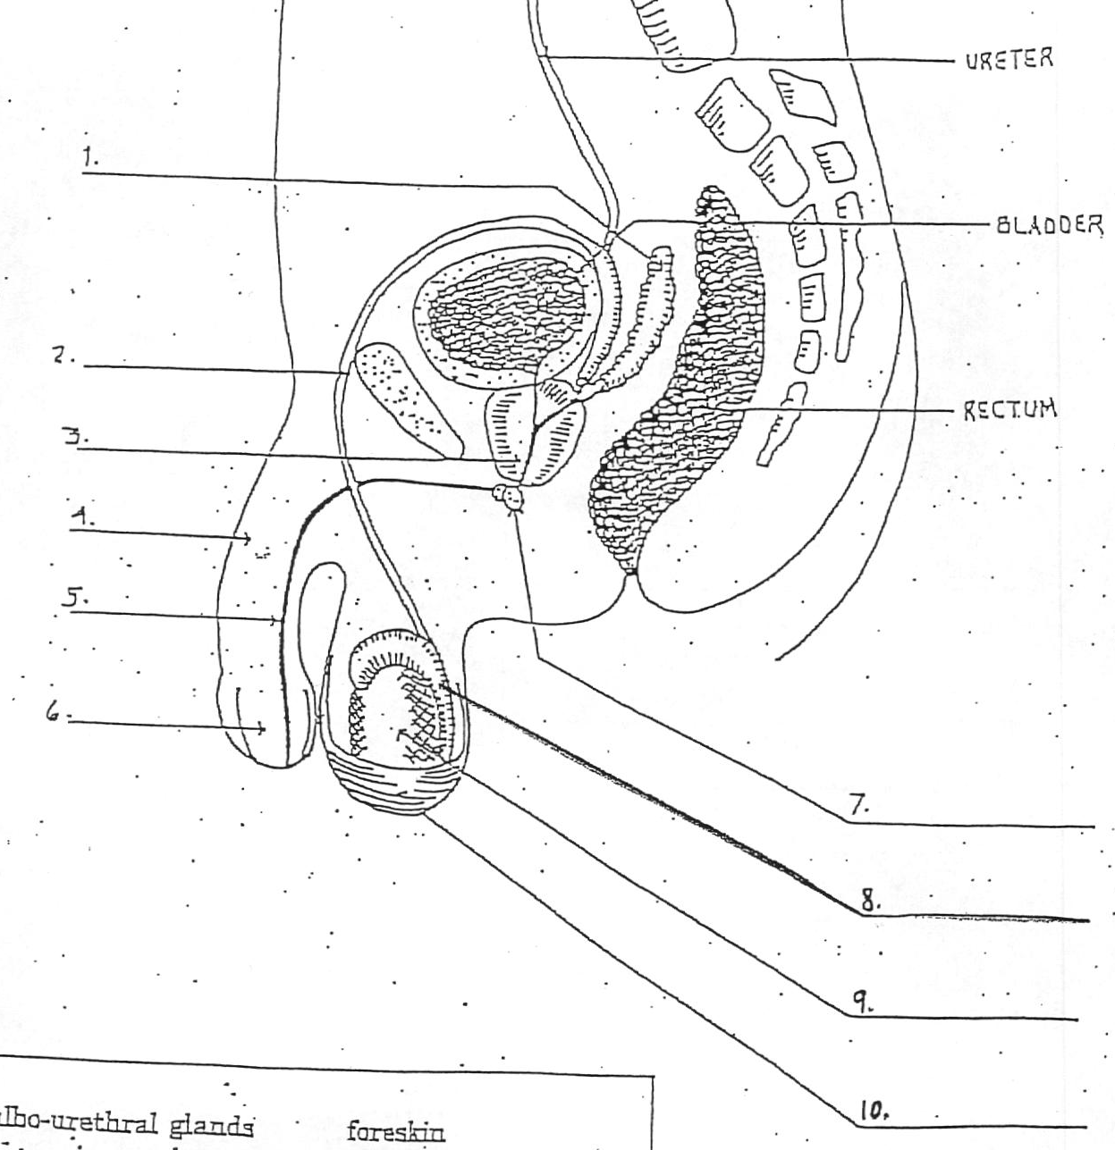
Male Reproductive System
#1 – Seminal Vesicle-2 small glands, secrete sugary fluid that provides energy for sperm
#2 – Vas Deferens-tube sperm travels through
#3 – Prostate-acidic fluid, helps sperm live long
#4 – Penis-male sex organ
#5 – Urethra-tube serves as passageway for semen and urine
#6 – Foreskin-protects
#7 – Bulbo-urethral gland (cowper’s gland) 2 glands on side of urethra, secretes lubricating fluid
#8 – Epididymis-structure on upper surface of each testicle, stores sperm
#9 – Testicle-produce sperm cells
#10 – Scrotum-sac that holds the testes, controls temperature

